Slide 1
Education for Critical Thinking: Schrodinger’s Cat in a Multiverse?
A talk for ASA’s Annual Meeting, July 23, 2016 — by Craig Rusbult

Slide 2
Education for Critical Thinking:
A central mission of ASA is helping people… improve the quality of evaluative Critical Thinking in schools (k-12, college, graduate) and churches, and in society. To do this, two useful educational strategies are Critical Thinking ACTIVITIES (such as recognizing & minimizing uses of logical fallacies) + constructing-and-evaluating claims (notice the activity-VERBS ! ) and Discussions about Evaluation.
For MORE about this and other topics , designprocessineducation.com/asa/

Slide 3
Logic and Psychology/Sociology
Later, my talk-abstract (in blue-green font) says: These questions [about Young-Earth Creation, Quantum Physics, and Multiverse Theology] are made more complex by interactions between our Logical Evaluations (of science-evidence obtained by observing nature , and theology-evidence by observing scripture) and worldview-related Psychology/Sociology Influences.
comment — This PowerPoint was too detailed for its viewers during the talk, but the details will make it more useful when you read it now, after the talk.

Slide 4
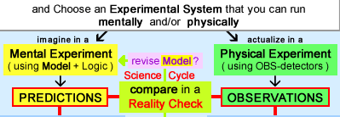
Empirical Evaluations in Science: In a REALITY CHECK you compare how you think it works, how it really works, zin theory-based in reality-based zzzPREDICTIONS OBSERVATIONS ( Model ≅ Theory(s) applied to the Experimental System )

Slide 5
Problem-Solving Process:
…ACTIVITIES + problem-solving Design Thinking , as in a model of Design Process that’s an extension of my PhD work about Scientific Method.
Partly because of my studies-of-science in History of Science, Integrated Scientific Method (my model) has 3 kinds of Evaluative Factors: Empirical + Conceptual + Cultural-Personal.
• Empirical = Hypothetico-Deductive Logic. • Conceptual = elegance, simplicity (O’s Razor)… • Cultural-Personal = Sociological-Psychological.

Slide 6
Cultural-Personal Factors
My model for Scientific Method includes many kinds of Cultural-Personal Factors: Metaphysical Worldviews, Ideological Principles, Opinions of Authorities, Cognitive Dissonance, Psychological Motives, and (by asking “how will it affect my life if I accept this view? will my life become better or worse?”) Practical Concerns.

Slide 7
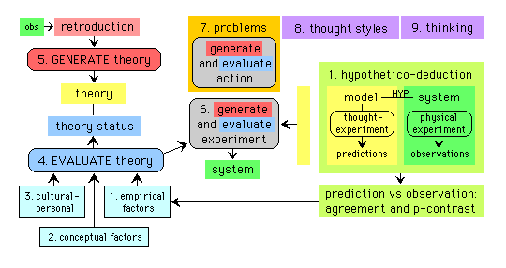
Cultural-Personal & Thought Styles
My model has 3 Evaluation Factors ( 1 2 3 ), and cultural-personal Thought Styles ( 8 ): [ sociological-psychological ]

Slide 8
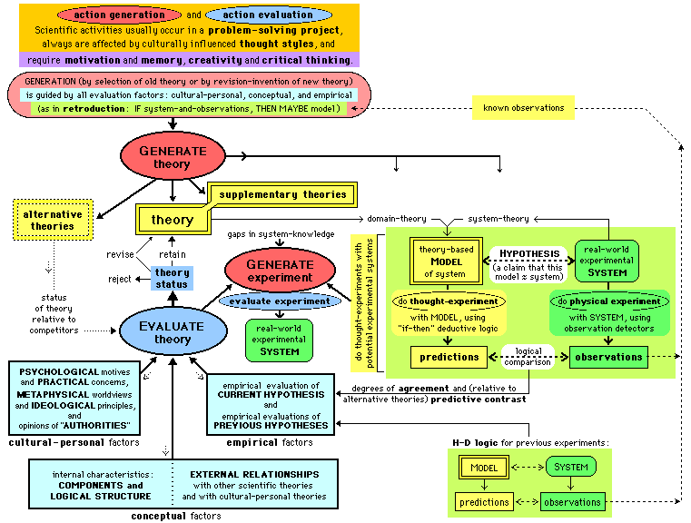
my model for Scientific Method:

Slide 9
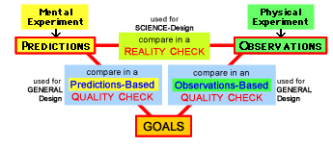
3 Comparisons of 3 Elements in my model for Design Process ( for Design-Thinking Process )

Slide 10
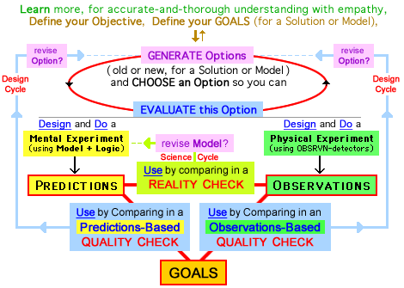
Conceptual and Cultural-Personal Factors are not explicit in my model of Design Process

Slide 12
We’ll look at three science/faith areas:
1) Young-Earth Creation ,
2) Quantum Physics ,
3) Multiverse Theology .
For important questions in these 3 areas, here are my conclusions about the results of evaluations based on science-evidence:

Slide 13
Is the science-evidence strong?
It’s very strong for two questions we’ll examine: • 1 – Is the earth young? (science says NO) • 2 – Does observation create reality? (NO)
But it’s not strong for three other questions: • 2 – Is a Many Worlds Interpretation (MWI) scientifically plausible or useful? (?) • 3 – { is MWI theologically satisfactory? } (NO) • 3 – Was nature intelligently designed? (?)
For all five questions, Science-Evidence is usually supplemented by Cultural-Personal Criteria, so…

Slide 14
Education for Critical Thinking:
As described in Slides 3-8, people use several kinds of criteria — Empirical (Science Evidence), Cultural-Personal (Sociological-Psychological), and Conceptual — when they evaluate claims. All of these factors should be considered by anyone (a teacher,…) who wants to improve critical thinking or wants to persuade. To do these well, we mainly use LOGIC to understand the Science Evidence and use EMPATHY + LOGIC for all kinds of criteria, but empathy is especially important for Cultural-Personal Criteria.

Slide 16
1 — Young-Earth Creationism
When we study young-earth theology & science , we see very strong interactions between logical evaluations and sociology/psychology influences that are based on a Christian worldview and also on other factors.
On the next page is a useful diagram (made by Deborah Haarsma, adapted by me) showing the parallel relationships between evaluations using theology-evidence from observing SCRIPTURE , science-evidence from observing NATURE .

Slide 17
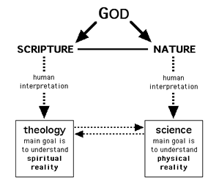
for Logical Evaluations

Slide 18
Logical Evaluations
This diagram shows a logical error often made by young-earth creationists, when they want to compare SCRIPTURE with Science. But all we can do is compare Theology with Science.
• Their assumption/claim is… wrong: “our Theory-of-Scripture = Scripture” by ignoring their own “human interpretation”. • Instead they should think in a way that is… correct: “our Theory-of-Scripture is a ‘human interpretation’ of Scripture that is fallible.” ( Bible is infallible, interpretations are fallible )

Slide 19
a FRAMEWORK Theory of “Days” is compatible with an old Universe. 2 Problems: Creation is “formless and empty”. 2 Solutions: make forms (1-3) and fill forms (4-6), with parallels between 1-and-4, 2-and-5, 3-and-6. If you carefully study Scripture in Genesis 1, you will see the logical framework for topical history. (creation-history can be described chronologically or topically)

Slide 21
2 — Quantum Physics
• Schrodinger’s Cat Experiments show us that conscious human “observation” is not needed to “collapse the wave function” and “create reality”; instead of OBSERVATION it’s INTERACTION.
• Many Worlds Interpretation is not necessary.
• to explain conversion of quantum-into-macro, Quantum Decoherence is MUCH better than Quantum Mysticism (“Mystical Physics”).
• proper logic-for-LEVELS requires matching: use Macro Common Sense for Macro Level, Quantum Common Sense for Quantum Level.

Slide 22
#B – Variation of Cat Experiment:
Cat Experiments: radioactive decay in original #A.
In #B — We shoot one electron thru double slits, with everything symmetric, so it’s 50-50 chance of electron hitting in top or bottom half of wall, and there is an obvious PHYSICAL INTERACTION.
RULES of our CAT-GAME: • If electron hits in top half of wall, cat lives. • If electron hits in bottom half of wall, cat dies.

Slide 23
Observation versus Interaction
I think they used a bad word in late-1920s, because observation leads to misconceptions; interaction actually causes quantum “events”, from start of universe (no human “observers”) into the future, for ZILLIONS of quantum events.
Consider these 4 meanings of observation: physical interaction (causes quantum “events”), human experimental design (sometimes relevant), human passive observation (always irrelevant)*, human consciousness (most scientists say “no! ”). * as with incorrect “extramission” theory of vision

Slide 24
Quantum Mysticism → Confusion:
AUTHORS who promote Mystical Physics can cause misconceptions by using a wrong meaning of observation, and shifting between meanings. READERS want to be fooled because they want the power (celebrated in New Age religion) to “create their own reality”, and to believe their claim-for-power is supported by science.
This Psychological Influence can overpower scientific evidence-based Logical Evaluation.

Slide 25
Do humans create reality?
In Reality 101 , I compare two kinds of reality: Human-Independent Realities (e.g. Solar System), Humanly-Constructed Realities (e.g. SS Theories). e.g. What reality(s) did and didn’t change from 1500 to 1700? Theories about SS? (yes) SS? (no)
a key concept: We can change some realities by the ways we think ,* but not other realities.
Our thinking cannot change results of quantum events, says conventional Quantum Physics, and almost all scientists.

Slide 26
The Importance of Our Thinking:
* Above, I describe a key concept: We can change some realities by the ways we think , but not other realities. But the realities we can change are very important. For example,
Romans 12:1-2 — Offer yourselves as a living sacrifice to God, dedicated to his service and pleasing to him. This is the true worship that you should offer. Do not conform yourselves to the standards of this world, but let God transform you inwardly by a complete change of your mind. Then you will be able to know the will of God – what is good and is pleasing to him and is perfect.

Slide 27
but … Do we create the universe?
For 13.8 billion years , natural process in the universe happened without human observation because zillions of “wave-function collapses” (in usual non-MWI interpretation) were caused by natural interactions, not human consciousness. { interactions include electronic transitions, etc }
But the Participatory Anthropic Principle is a claim that “consciousness” (of a human? a dog? God?) is necessary for existence of any universe. This arrogant claim is scientifically unsupported. is it disproved? or just EXTREMELY implausible?

Slide 28
#C – Variation of Cat Experiment:
Similar to Experiment #B in using a Wall-Sensor but #C also includes TIME-DELAYED Observation. #C uses: Cat with 2 weeks of food & water, Typewriter that receives result from Wall-Sensor and types “Topp” or “Botm” on paper and (optional)* we hear (observe) striking-sounds, Camera takes a 2-week video of paper-and-cat. * or (why?) do #C without this observation.
We wait two weeks, then look inside the box to observe the results for cat & paper & video.

Slide 29
Does observation cause results?
• One Explanation — using Quantum Mysticism: A person who claims “observation by human caused all results (for sensor , cat, paper, video)” must propose a mechanism. Does something “go out” from the human’s eyes and time-travel back 2 weeks to cause all of these results?
• Better Explanation — Quantum Decoherence: When “electron interacts with wall” it causes an irreversible sequence of events (like “a good way to bet” in 2nd Law of Thermo) that converts the quantum event into macroscopic results.

Slide 30
Don’t mis-match logic of LEVELS.
Avoid mis-match of logic from different LEVELS: If you use Macro-Level Logic for events at the Quantum Level , mis-understandings can occur. And using Quantum-Level Logic for events at the Macro Level can cause misunderstandings.
and… Interactions Between Levels shows us that
strange behavior at the Quantum Level produces normal behavior at our familiar Macro Levels

Slide 31
Do match the logic of LEVELS.
Instead of what to avoid (don’t mis-match), think about what you want to do (do match).
When you’re thinking about events at Quantum Level , use Quantum-Level Logic.
When you’re thinking about events at Macroscopic Level , use Macro-Level Logic.

Slide 32
Science limits the Strangeness:
“Do not keep saying to yourself, if you can possibly avoid it, ‘But how can it be like that?’ because… nobody knows how it can be like that.” (Richard Feynman, Nobel Prize Winner)
To understand quantum-level events, be creative (to imagine quantum strangeness) and logically critical so you realize that… YES, things really are strange, but… NO, things are not as strange as some people say they are with their Quantum Mysticism, aka Quantum Flapdoodle.

Slide 33
Many Worlds Interpretation , MWI
For the Time-Delayed Cat Experiment (#C), MWI claims that all possibilities occur (at the quantum level through macroscopic level) when electron-hits-wall and for the next 2 weeks, with exponential splitting into zillions of “branches of reality” in actualized alternative MWI-Realities. When we ask “what happens?”, MWI claims “everything happens.” In fact, MWI claims EVERYTHING HAPPENS not just for “experiments” but for all events in the history of our universe, from its beginning.

Slide 34
MWI – Is it plausible? useful?
To evaluate a theory, scientists – and others – can ask “is it plausible?” and “is it useful?” (is it useful for science, philosophy, religion, politics, career, ego, or in other ways?)
MWI and non-MWI are scientifically plausible. By using only evidence-and-logic, neither can say “the other interpretation is definitely wrong.” MWI and non-MWI are useful in many ways;* Decoherence → MWI is not needed for science.
* But MWI is unsatisfactory for theology !

Slide 35
2 - Quantum Physics (review)
• Schrodinger’s Cat Experiments: show us that conscious human “observation” not needed to “collapse wave function” and “create reality” ; instead of OBSERVATION it’s INTERACTION.
• Many Worlds Interpretation is not necessary.
• to explain conversion of quantum-into-macro, Quantum Decoherence is MUCH better than Quantum Mysticism (“Mystical Physics”).
• proper logic-for-LEVELS requires matching: use Macro Common Sense for Macro Level, Quantum Common Sense for Quantum Level.

Slide 37
3 — Multiverse Theologies
the bottom line: I think that theologically, non-MWI multiverses would be satisfactory, but an MWI multiverse is definitely unsatisfactory.
Why? We’ll look at : … • apologetics value? arguments by theists, for a Divine Designing of Nature, are weakened by a multiverse, but this is “so what?” for theology. • human duplicates? a multiverse with non-MWI has Here-and-Now accountability; with MWI everyone does everything → not accountable.

Slide 38
Intelligent Designing of Nature?
In recent decades, scientists have discovered that many properties of universe are “just right” for life. For example, sunshine occurs due to a “tug of war” balance between in-pulling gravity force and out-pushing nuclear force. Imagine a control panel with dozens of dials. To allow life, each dial (controlling one property of nature) must be “fine tuned” within a narrow range. These dials ARE properly tuned to allow stars (for atoms & energy, the chemistry of DNA, water, and proteins, and much more.

Slide 39
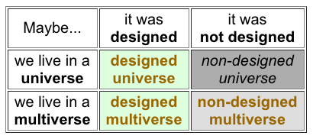
4 Theories to explain Fine Tuning :
WHY is our universe “fine tuned” for life?
3 theories (all except non-designed universe) seem plausible, so claims for Divine Design of the Universe cannot be proved or disproved. This → apologetics preferences for or against multiverse, but theologically it doesn’t matter.

Slide 40
Beating the Odds in a Multiverse
How can a multiverse “explain” fine tuning? In a universe, high odds against fine tuning. But the odds change in an immense multiverse. For example , if deal one poker hand , odds of getting Royal Flush are 1 in 649,740. Odds are 50-50 with 450,365 hands. With 9 million deals, odds favor Royal Flush(s) by million-to-one.
For multiverse with string theory determining universe-properties, 10⁺⁵⁰⁰ different universe-types. If probability of Fine Tuning is 10⁻⁴⁰⁰ in 1 universe , odds-in-multiverse favor fine tuning.

Slide 41
Theology: non-MWI ≠ MWI
More specifically, a Theology-of-JUDGMENT seems OK if non-MWI, but not-OK if MWI.
 | and if it’s normal non-MWI , theology is | and if it’s strange MWI , theology is
If One Universe | OK. | not-OK.
If Many Universes in a Multiverse | OK. | not-OK.

Slide 42
Here-and-Now → Accountability
IF you live in a universe in a multiverse, and IF your universe-type has immense (not infinite) number of actualizations, other universes might have “duplicates of you” with almost-identical experiences. Is this a theological problem? No. You are not an omnipresent being who can observe all duplicates. You are responsible for only your Here-and-Now thoughts/actions in this universe. What any “duplicate” might do is irrelevant for you. Each person is responsible for their own life in their own universe.

Slide 43
MWI – Theological Problem #1a
IF our universe continually quantum-splits at every instant, to form an exponentially immense “tree” of universes, you will make every possible decision, and do every possible action, at every instant of your life. You do everything, ranging from actions that are very evil to very good. And your faith ranges from none (saying “NO to God” always) to devout (saying “YES” in all ways). MWI causes a theological problem when we ask “which ‘you’ will be judged by God ?” based on your faith-and-actions during your life(S) ?

Slide 44
Judging our Faith-and-Actions:
The Bible teaches that God will judge each person by their FAITH and their ACTIONS.
We can imagine getting a “total Life-Score” from God, based on our Faith {which is complex, multi-dimensional} and Actions {which also are complex and multi-dimensional}. A simplified graph shows “total FAITH-Score” and “total ACTIONS-Score” on one-dimensional axes, with {certainly wrong} equal weighting. These combine to get a “total LIFE-Score”.

Slide 45
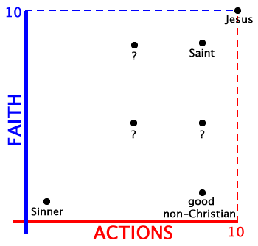
Scores: FAITH + ACTIONS = LIFE

Slide 46
Judging with non-MWI and MWI:
As explained earlier, MWI causes a theological problem when we ask “which ‘you’ will be judged by God ?” based on your faith-and-actions during your life(s).
Why? As shown in the next two slides , • in a normal non-MWI universe, each person can get ONE “Life-Score” from God, which is consistent with the way we view life. But… • in an MWI-universe, each person would get ALL “Life-Scores” from God. ( seems strange! )

Slide 47
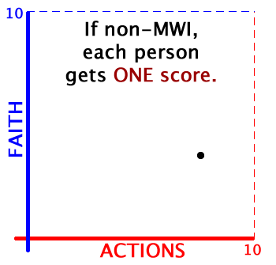
if non-MWI , then each person could get
ONE “LIFE-score” for FAITH-and-ACTIONS:

Slide 48
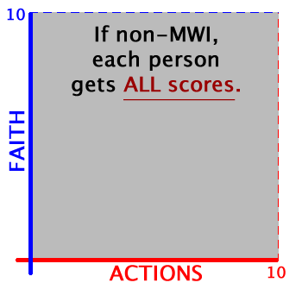
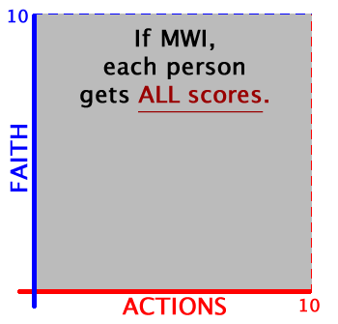
if MWI , then each person should get
ALL “LIFE-scores” for FAITH-and-ACTIONS:

Slide 49
MWI - Psychological Influences
Asking “in an MWI-Universe, which ‘you’ will be judged?” is a theological problem for a theist (Judeo-Christian or Moslem) so it can become a religious reason to reject MWI because it’s non-useful psychologically/sociologically. But for a non-theist this is not a problem, and it could be a religious reason to accept MWI.
MWI also increases the number of universe-actualizations, which is a factor when evaluating claims for a Divine Designing of Nature. This is an apologetics reason to reject or accept MWI.

Slide 50
MWI – Theological Problem #1b
Divine Sovereignty: Judeo-Christian theists should believe that in a multiverse the many things happening include only what God allows to happen.
By contrast, typical secular MWI claims “everything that CAN happen DOES happen” with NO CONTROL by God.

Slide 51
Theistic Views of Nature:
• theists should not accept atheistic views of nature claiming “natural process occurs without God” with no divine supervision, with no ability to control. ( or claims that divine miracles are impossible in formative history or human history) But “how & when did/does God use miracles ? ” )
• we also should reject atheistic interpretations of multiverses.* But… is it possible to construct a theistic version of MWI that is authentic MWI ? not just pseudo-MWI ? (* MWI-Multiverse ≠ Normal Multiverses; Tegmark’s 1+2 versus 3.)

Slide 52
Science in a Multiverse…
would be normal-appearing due to the principle of Here-and-Now. All aspects of life — including our science — would appear normal, because “you are not an omnipresent being” who can observe what’s happening in all multiverses. Instead in each universe what is most likely to happen is what is most likely to be observed. Strange things might be happening somewhere in the multiverse, but not where you are. (so it would not be an “Alice in Wonderland” world)

Slide 54
Is the science-evidence strong?
It’s very strong for two questions we examined: • 1 – Is the earth young? (science says NO) • 2 – Does observation create reality? (NO)
But it’s not strong for three other questions: • 2 – Is a Many Worlds Interpretation (MWI) scientifically plausible or useful? (?) • 3 – { is MWI theologically satisfactory? } (NO) • 3 – Was nature intelligently designed? (?)
For these questions, how is Science-Evidence supplemented by Cultural-Personal Criteria ?

Slide 55
Responses to Science Evidence:
For the 5 questions we’ve examined, how do people respond to the Science Evidence? Science Evidence is very strong for the first 2 questions, but some people reject this logical evidence because they are strongly influenced by Cultural-Personal Criteria. Science Evidence “does not strongly support any view” for the final 3 questions. For these 3, Cultural-Personal Criteria are used by everyone but are not used in the same way by everyone.
The 5 questions, summarized with more detail:

Slide 56
Science Evidence + Cultural-Personal
1 – Young-Earth Creation ? Science Evidence strongly supports an Old Earth-and-Universe. Theology Evidence doesn’t strongly support Old or Young. Cultural-Personal strongly influences accepting of Young Earth. (and accepting of Old Earth, but I think to a lesser extent)
2 – Observations by Conscious Humans ? Science Evidence strongly says “consciousness doesn’t matter.” Cultural-Personal is a strong influencer of those who want the power to “create their own reality” when they “observe.”
2 – Many-Worlds Interpretation (MWI) ? Science Evidence doesn’t strongly support MWI or non-MWI. Conceptual Factors (elegance,…) can be reason to accept MWI. Cultural-Personal Factors can be reasons to accept or reject.

Slide 57
Science Evidence + Cultural-Personal (every situation is a different mix of SE and C-P)
3 – MWI Theology ? ( Judgment + Sovereignty ) Science Evidence doesn’t strongly support MWI or non-MWI. Theology Evidence: Theology is satisfactory for a multiverse that is non-MWI/HereNow, but unsatisfactory for MWI-universe, re: divine judgment and sovereignty. This could be a reason for theists to reject MWI, but for non-theists to accept MWI.
3 – Intelligent Design of Nature ? Science Evidence does not strongly support Yes or No, if we consider claims to “beat the odds” with an immense multiverse. Cultural-Personal: a multiverse weakens support for claims that “Nature was Designed” so this is a (non-theological) reason for theists to reject multiverse claims, for non-theists to accept.

Slide 58
Education for Critical Thinking:
People use a variety of criteria — Empirical (Science Evidence), Conceptual, and Cultural-Personal (Sociological-Psychological) — when we evaluate claims , so all of these factors must be considered by all of us (teachers and others) who want to improve critical thinking or want to persuade.* Teachers/persuaders mainly use LOGIC to understand the Science Evidence and EMPATHY + LOGIC for Conceptual Factors and (especially) for Cultural-Personal Factors. (* and recognize that every situation is different )

Slide 59
responsibility to avoid mis-education:
When science evidence is very strong – e.g., for young-earth creation & quantum observation – I think writers/speakers have a responsibility to accurately describe the science.
For these questions, I view “authorities” and their “audience” differently. The writers should know their science, and it’s difficult to imagine how they don’t know that what they are saying is wrong. By contrast, their readers TRUST those who claim to know more science, so the readers seem to be victims of intentional mis-education.

Slide 60
self-defense to avoid mis-education:
In high school, a teacher showed how to defend ourselves (and others) against mis-education. How? Although he was a good “explainer” with direct lecture-teaching, the most valuable part of his teaching was our in-class debates, when he would skillfully defend one view Monday, but on Tuesday he attacked this view and defended another view. After he did this many times, we learned lessons (about Accurate Understanding and Respectful Attitudes) described at the end of my abstract and when you click the links:

Slide 61
Understanding and Respect
We’ll examine these [psychological/sociological] factors, along with lessons learned from my high school teacher who [in “Monday and Tuesday” debates] helped us improve our understanding (of all perspectives) and our respecting (by recognizing that differing views are defensible , logically and ethically) [ avoid hostile tribalism ], thus encouraging appropriate humility that is not too little [it’s not arrogant] and, avoiding radical postmodern relativism, is not too much.
LINKS – ASA Website – Origins – Design Process

