Slide 1
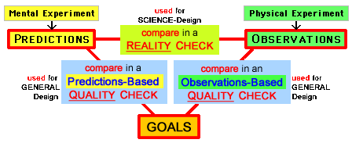
Building Bridges for All Students with Problem-Solving Education
diagrams & links – EducationForProblemSolving.net/eed/
How can we use our ideas for Problem-Solving Education in ways that will help all students improve their problem-solving abilities, as part of our efforts to produce better diversity, equity, and inclusion?

Slide 2
The next few slides (before the first "blank slide" that shows a topic-change) are explanatory comments that I'm making after the seminar. My purpose for the first slide (above) was giving people in the seminar room (or on Zoom) something interesting to look at and think about while they were waiting, before I began talking.

Slide 3
After my seminar (September 22, 2022) I revised this page by rearranging MANY slides and adding links and in other ways, like adding a "blank slide" between major changes-of-topic. This PowerPoint summarizes many of my main edu-ideas, and why I'm so excited about them. But for a deeper understanding you can study the Introductory Overview in my comprehensive website about Education for Problem Solving. During the last week of September I'll be making a Short Overview that is a "bigger picture" view of ideas in the website. And my seminar-page has abstracts (short and longer) for ideas in the seminar and website, plus an informal bio.

Slide 4
In this PowerPoint, the LINKS are gold.

Slide 5
Of course, during the seminar I didn't cover all of the ideas in this PowerPoint ( nobody could talk that fast or listen that fast ! ) but you can digest the ideas more slowly now.
And, as described in the previous slide, I recommend studying the Introductory Overview (that includes the Short Overview) where the ideas are explained more thoroughly.

Slide 7
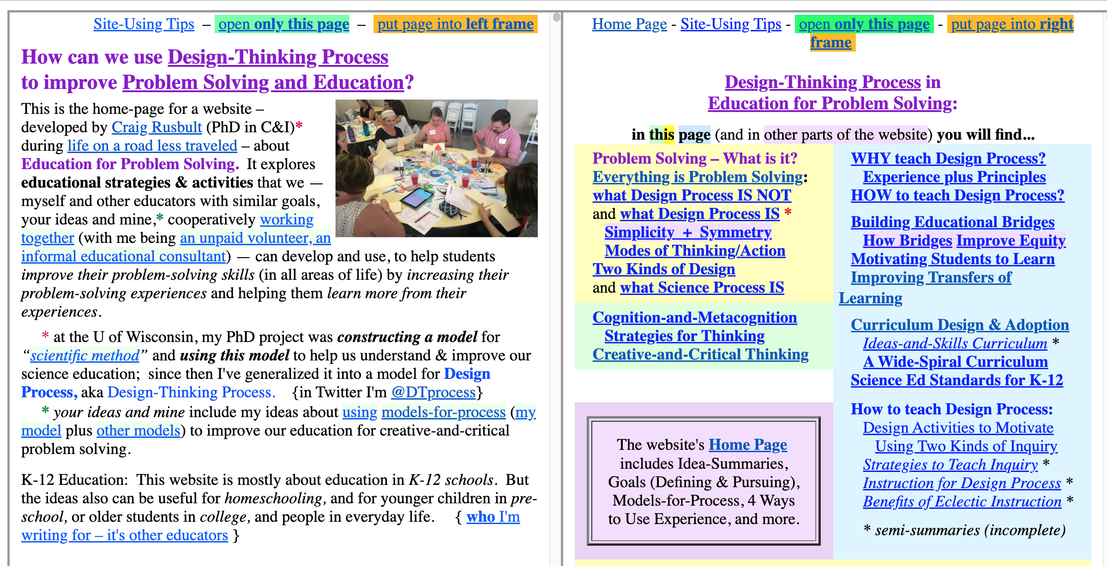
For using my edu-website ( Education For Problem Solving ), 3 tips: use a BIG Screen – open LEFT+RIGHT and click links because a link usually will open in the "other side" frame so you can continue reading in the frame where the link was. And you can "open only this page" with a top-of-page link.
LEFT SIDE is homepage RIGHT SIDE has in-depth with Intro-Overview. examination of topics.

Slide 9
Building Bridges for All Students with Problem-Solving Education
by Craig Rusbult, PhD – September 22, 2022 ( a seminar for OSU's Dept of Engineering Education )
_______________________________________________________________________________
WHY should we Build Bridges? What are the benefits? When we Build Bridges, we can help students improve their TRANSFERS of Learning (for their Skillful Uses of Knowledge) Across Areas (between School-Life & NonSchool-Life), and TRANSITIONS of Attitudes (Confidence & Motivations) with "transfers" Through Time ( Past → PRESENT → Future ).

Slide 10
my claims about Objectives and Process:
I think people use a similar Process of Problem Solving for almost everything we do in life, in most areas of life.
This claim is based on logically combining two sub-claims:
A) our Problem-Solving OBJECTIVES include almost all we do,
B) our Problem-Solving PROCESS is similar for almost all we do.
For awhile, these two claims will be our focus, beginning with
A) why PS-OBJECTIVES include almost everything we do.

Slide 11
the scope of PS-Objectives is wider when we choose broad definitions:
EDUCATION is learning from life-experiences.
PROBLEM is an opportunity to make something better. (better in any way, in any area of life)
PROBLEM SOLVING is whenever you do make something better.

Slide 12
A) With these broad definitions,
your Problem-Solving OBJECTIVES (what you choose to make better) can include almost everything in your life.
because your OBJECTIVE can be (with my categorizing) a
product - activity - relationship - strategy - theory
(often there are overlaps, so it's product and/or activity and/or...)

Slide 13
For many reasons, it's educationally useful to split
these kinds of OBJECTIVES into two kinds of Design:
product - activity - relationship - strategy – theory
can be categorized into two kinds of design:
product - activity - relationship - strategy
in GENERAL Design (in Engineering & other Areas)
product - activity - relationship - strategy – theory
in SCIENCE-Design (in Science, Engineering,...)

Slide 14
HOW can Educational Bridges increase Transfers Across Areas?
A) By using broad definitions for Problems & Problem Solving, Problem-Solving OBJECTIVES include almost everything we do. And in a second wide scope,
B) my model for Design Process shows how we use a similar Problem-Solving PROCESS for almost everything we do. Notice that, in my model , Problem-Solving Process is Design Process

Slide 15
Why should you accept these two claims?
A) A wide scope for Problem-Solving OBJECTIVES is easy to show — IF you think my broad definitions are reasonable — and the wide scope of PS-Objectives lets us design PS-Activities that are FUN and (as perceived by students) are USEFUL. B) Later I'll show how my model for Design Process – for the Problem-Solving PROCESS that people use for most things we do in life — is an accurate description of how we actually use creative-and-critical thinking while we solve problems. If students believe that PS-Process (used by them in School) will be Personally Useful (in Life), they will be motivated to invest in their own Personal Education.

Slide 16
HOW ? using Design Process leads to wide scopes for...
A) Problem-Solving OBJECTIVES , B) Problem-Solving PROCESS.
PLUS – How People Learn: Brain, Mind, Experience, and School
How People Learn (from National Research Council) says transfer is "the ultimate goal of learning" so it's "a major goal of schooling," and recommend (based on research about learning) that to increase transfer, we should: A) teach knowledge in multiple contexts; this is encouraged by the wide scope of PS-Objectives; B) teach knowledge in a form that's easy to generalize; Design Process does this by using a similar PS-Process across the wide range of PS-Objectives and PS-Activities.

Slide 17
How People Learn says that – to increase transfer – we should "teach knowledge in a form that's easy to generalize" and easy-to-generalize occurs with my model for Design PROCESS, for Problem-Solving PROCESS.

Slide 19
Why should you accept my bold claims?
Is there "PROOF beyond a reasonable doubt"? – NO. Are there logical REASONS for "a good way to bet"? – YES.
We have logical reasons to predict that using Design Process is a good way to bet, can be useful in educational projects, is worth developing with investments of time, money,...

Slide 20
The logical reasons are analogous to logic in my PhD project,
when my two sub-projects were ... 1. developing a model for Scientific Method, 2. then using this model to analyze instruction.
During that time the logic was: Scientific Method(s) → scientists do Science-Actions. IF students do these Actions during the instruction, probably they will improve their Science-Actions. But this is a logic-based PREDICTION (re: a good way to bet), not an OBSERVATION that using D-Process improves Actions.

Slide 21
And now these logical reasons are analogous to my claims:
How People Learn (with its basis in educational research) provides logical support — because HPL claims that transfer can be increased by A) teaching in multiple contexts, and B) teaching generalized principles,
similar to my claims that we can use Design Process to make wide scopes for A) PS-Objectives, and B) PS-Process, and that together (with their A+B and my A+B) this provides a logical reason to think Design Process may increase transfer.

Slide 23
I want to work cooperatively with other educators to develop our ideas for improving education, by creatively-and-synergistically combining MY experiences-understandings-skills with YOUR experiences-understandings-skills. I've been thinking mainly about education for K-12, but most ideas also can be used for college education.
If you find my ideas interesting – even if (maybe especially if) you're thinking "yes, but..." because you agree partially (yes) but not totally. Of course that's ok, and it could help both of us learn if we discuss your reasons for "yes" and also "but".

Slide 24
Building Bridges for All Students, with Problem-Solving Education
Building Bridges with Problem-Solving Education, for All Students The two title-colors show two fairly-independent ideas (and I think both ways-to-arrange have similar meanings?) because we could improve Problem-Solving Education but do it in ways that don't help "all students" and instead lead to LESS diversity-equity-inclusion.
The colors also show areas where I feel competent, and areas where I think people in OSU's Engineering Education know much more about "how to do it" compared with me.

Slide 26
We want to build effective Edu-Bridges so students will be motivated to pursue their own Personal Education,
therefore we should develop Activities that are FUN and USEFUL

Slide 27
The wide scope of Problem-Solving Objectives (and thus of possible Problem-Solving Activities) makes it easier for educators to creatively design a variety of Activities that are FUN and USEFUL.

Slide 28
Designing Activities that are FUN and USEFUL :
FUN (with intrinsic experience) happens when activity has fun TOPIC that (for a student) is interesting, fun ACTIONS (by a student) that are interesting.
FUN (satisfying result-of-success) when student anticipates success, and achieves success. So this happens more often, design activities with appropriate level of difficulty (not too easy, not too hard) a well designed PS-Activity is similar (re: difficulty) to a a well designed mystery story — so most students are not bored (if too easy) and not frustrated (if too hard).

Slide 29
USEFUL is defined by a student.
During an Activity, a student will perceive USEFUL-ness when they think & feel (in their thoughts & emotions) that the Activity will be USEFUL for their own future life — their near future (after school), medium future (next year), and far future (as an adult) — because they're deciding that what they are doing-and-learning will be Personally Useful in their own lives, and this belief motivates them to pursue their own Personal Education.
They are being motivated by their imaginings of TRANSFERS Across Areas (from School into Life) and TRANSFERS Through Time (from Present into Future).

Slide 30
Personal Education: Area-Transfers & Time-Transfers:
When students decide that they want to pursue their own Personal Education, they're motivated by imagining TRANSFERS Across Areas (from School into Life) and TRANSFERS Through Time (from Present into Future).
There are logical reasons (e.g. earlier I described the A-and-B of OBJECTIVES-and-PROCESS with wide scope) to accept Transfers Across Areas. By contrast, accepting "transfers" Thru Time depends more on the thinking of a student: Are they imagining the ways that their present School-Learning will improve the quality of their future Life-Living?

Slide 31
Personal Education is Problem-Solving Education:
We can ask students to... think about their goals for life (involving themselves & others)* and develop a proactive problem-solving approach for their education, asking "how can I solve a problem – by making my education better and making my life better – and help me achieve my goals for life?"
(* and help others have better lives, with win-win goals & results?)
Personal Education is proactive problem solving. A student tries to make things better because they believe that... improving School-Life improves their Whole Life because better Education produces a better Life; making Their Education better will make Their Life better.

Slide 32
Past PRESENT Future
Student Expectations: When students think they will get TRANSFERS of Learning Across Areas and Through Time , this can produce TRANSITIONS in Attitudes:
SCHOOL
LIFE
MOTIVATIONS:
If I improve my PS-Skills NOW in School, I can use my improved PS-Skills LATER in Life.
Notes:
This is what only I will see?

Slide 33
Past PRESENT Future
and TRANSFERS (Across Areas & Through Time) can produce TRANSITIONS in Attitudes:
LIFE
SCHOOL
CONFIDENCE
I've done PS-Process BEFORE in Life, so I can do it NOW in School.
Notes:
This is what only I will see?

Slide 35
A student's perception of Personal Useful-ness provides their motivation for Personal Education.
________________________________________________________________________________
Here are some useful self-education strategies (that most of you already know) for Personal Education:
• developing and using (with consistency) a Growth Mindset,
• trying to learn from every experience (good or bad) with a proactive attitude of Intentional Learning,
• believing that Better Learning NOW will lead to Better Performing LATER,
• developing-and-using a Checklist for Problem Solving.

Slide 36
Growth Mindset: develop-and-use it consistently, so — whenever you ask "how well am I doing in this area?" and honestly answer "not well enough" — you are thinking "not yet" (instead of “not ever”) because you are confident that in this area you can "grow" by improving your skills, when you invest intelligent effort in your Personal Education. An effective growth mindset combines honest accuracy (in self-perception) with reasonable optimism (about being able to grow by improving).
Intentional Learning: Students do goal-directed Personal Education by defining worthy goals-for-life (to improve their self and life-situations) and making practical plans for achieving their goals, by pursuing their goals with effective activities and intelligent effort.

Slide 37
Past PRESENT Future
Performance Objective = want best performing NOW.
Learning Objective = want best learning NOW so can improve best performing LATER.
Learning NOW
Performing LATER
examples from basketball: you have Learning Objective in early-season practice , Performance Objective in late-season tournament game.
Notes:
This is what only I will see?

Slide 38
Maya Angelou describes Performing and Learning: "Do the best you can until you know better. Then when you know better, do better." Or, with [my comments], Do the best you can [with high Present Performing] until you know better. Then [later] when you know better [due to Present Learning], do better [with high Future Performing].
Using an Objective-to-Perform usually is best short-term , but long-term it's best to ALSO sometimes use an Objective-to-Learn.

Slide 39
develop a Checklist for Problem Solving (making things better) with Actions in Design Process & from other sources, and use it consistently in relevant Areas of Life & Life-Situations.
When I make a mistake and – wanting to learn from the experience so I can "do it better" the next time – I ask "why?" the answer often is "my process wasn't effective" because some problem-solving actions had not been done well, or had even been omitted.
Often I could have avoided a "did it worse" mistake – and instead would have "done it better" — if (using Actions in Design Process as a checklist for questions) I had asked... Have I chosen a good Objective? (is this a wise use of my time?) Do I understand the Problem-Situation? Do I know what I want? (by defining Goals for a Problem-Solution); then, Have I Generated Options for a Solution? and Evaluated these Options? then... Have I Made a Decision, and Actualized the Solution with actions?

Slide 41
Now we'll look at my model for problem-solving Design Process.

Slide 42
Earlier, I say that...
Later I'll show how my model for Design Process – for the Problem-Solving PROCESS that people use for most things we do in life — is an accurate description of how we actually use creative-and-critical thinking while we solve problems.
But... before doing that, I'll comment on differences between my teaching style during the seminar and a teaching style that usually is much better for students in K-12.

Slide 43
Two Methods for Teaching Process-Principles:
Direct Explaining (by teacher), Discovery Learning (by student).
NOW, I'll do show-and-tell to explain our Problem-Solving Process.
LATER, With students, usually this is NOT a good teaching strategy.
Instead, help students DISCOVER PRINCIPLES-for-Process, by using EXPERIENCES + REFLECTIONS → PRINCIPLES . Their self-discovering will be more satisfying and effective.
But for NOW, Direct Explaining will be useful.

Slide 44
COMMENTS added during the post-seminar revision:
The slides above & below are similar, because I first made one (above) and then revised it.
I'm including both, because seeing the same idea twice (especially if it's an important idea, like this one) can be useful for understanding better.
I think the main "added value" in the revised slide (below) is at the bottom, with its description of ERP as Using a Process-of-Inquiry to Teach Principles-for-Inquiry

Slide 45
Two Methods for Teaching Process-Principles:
Direct Explaining (by teacher), Discovery Learning (by student).
when we are not in a seminar with very-brief TIME LIMITS, help students DISCOVER PRINCIPLES-for-Process,
EXPERIENCES + REFLECTIONS → PRINCIPLES
Their ERP self-discovering will be more satisfying and effective when we Use a Process-of-Inquiry to Teach Principles-for-Inquiry

Slide 46
But... there is an important factor to consider for K-12 students.
In college education educators can control WHAT students study and WHEN, but in a K-12 Curriculum that integrates Design Process (and other models) into a coordinated Wide-Spiral Curriculum with spiral repetitions (so students have problem-solving experiences in all grades), what a student learns in 1st Grade will affect their "discovery learning" in 2nd Grade, so instruction with ERP ( especially for Reflections ) will have to be adjusted.

Slide 48
Earlier, I say that...
Later I'll show how my model for Design Process ...
Now it's "Later" and I'll describe my model, beginning with the most beautiful diagram, with two colorful-and-logical triangles: look at the next diagram and find them.
Then (although probably it won't be necessary) I'll explain "what the triangles are" and why they're important.

Slide 50
THE TWO TRIANGLES: one has 3 Elements (Predictions & Observations, Goals); the other has 3 Comparisons AND two kinds of Design because there are two ways to think about this triangle, by describing the WHAT of its evaluative Actions, and the WHY of each ACTION.

Slide 51
Define – Solve – Decide & Do

Slide 52
Define – Solve – Decide & Do
1 - Define a Problem Choose an Area-of-Life with a thing you want to make better. Ben Franklin: "Time is the stuff Life is made of " so choose wisely, asking "What's the best use of my time right now? and later?" Learn about the Problem-Situation, to better Understand it, Choose an Objective (choose what you want to make better), Define GOALS (what do you want? what will make it better?).
2 - Solve this Problem creatively Generate Ideas (for Options) critically Evaluate Ideas (for Options) Ideas = Options for a Problem-Solution with interplay between creative thinking & critical thinking during creative-and-critical Process of Problem Solving.

Slide 53
Define – Solve – Decide & Do
1 - Define a Problem Choose an Area-of-Life with a Situation (to make better) Ben Franklin: “Time is the stuff Life is made of” so choose wisely. Learn about Situation, to better Understand the Situation Choose an Objective (choose what you want to make better) Define GOALS ( = what will make it better? )
2 - Solve this Problem creatively Generate Ideas (for Options) critically Evaluate Ideas (for Options) Ideas = Options for a Problem-Solution with interplay between creative thinking & critical thinking during creative-and-critical Process of Problem Solving.

Slide 54
Define – Solve – Decide & Do
1 - Define a Problem
2 - Solve this Problem creatively Generate Ideas (for Options) critically Evaluate Ideas (for Options)
3 – Decide & Do ( not shown in the diagram ) Solve this Problem (in Reality: Actualize Problem-SOLUTION)
Decide — when Evaluating → Choosing an Option Do Actions — that are required to Actualize This Option, so This Option becomes a Problem-SOLUTION.

Slide 55
you Evaluate by Using Experiments:
another broad definition ( useful for building bridges )
EXPERIMENT = any Situation that produces Experiences, is any opportunity to get Experimental Information – when you make PREDICTIONS in a MENTAL Experiment (internal) by imagining Situation → "what would happen if..." make OBSERVATIONS in a PHYSICAL Experiment (external) by actualizing Situation → "what does happen when..."
EXPERIMENT = any Situation that lets you Predict, any Situation that lets you Observe.
EXPERIMENT = Prediction-Situation or Observation-Situation.

Slide 56
you Evaluate by Using Experiments:
another broad definition ( useful for building bridges )
EXPERIMENT = any Situation that produces Experiences, is any opportunity to get Experimental Information. – when you make PREDICTIONS in a MENTAL Experiment (internal) by imagining Situation → "what would happen if..." make OBSERVATIONS in a PHYSICAL Experiment (external) by actualizing Situation → "what does happen when..."
EXPERIMENT = any Situation that lets you Predict, any Situation that lets you Observe.
EXPERIMENT = Prediction-Situation or Observation-Situation.

Slide 57
you Evaluate by Using Experiments:
another broad definition ( useful for building bridges )
EXPERIMENT = any Situation that produces Experiences.
EXPERIMENTAL DESIGN: In a broad general strategy,
ask "what can we do (re: our Problem) to get Useful Information?"
imagine "IF we do this Experiment, what might happen," and "what could we learn that might be interesting or useful?"
also – We can help students learn logically Designing Experiments, re: ways to make Experiments more useful for Problem Solving (e.g. Isolate & Control Variables; Control Groups; blind,...)

Slide 58
you Evaluate by Using Experiments:
another broad definition ( useful for building edu-bridges )
EXPERIMENT = any Situation that produces Experiences.
EXPERIMENTAL DESIGN: In a broad general strategy,
ask "what can we do (re: our Problem) to get Useful Information?"
imagine "IF we do this Experiment, what might happen," and "what could we learn that might be interesting or useful?"
also – We can help students learn logically Designing Experiments, re: ways to make E-Information more useful for Problem Solving (e.g. Isolate & Control Variables; Control Groups; blind Obs,...).

Slide 59
you Evaluate by Using Experiments: HOW do you Use ?
you Do Comparisons to
make a REALITY Check ( in SCIENCE-Design )
or
make a QUALITY Check ( in GENERAL Design )

Slide 60
3 Elements are used in 3 Comparisons for GENERAL Design and SCIENCE-Design:

Slide 61
SCIENCE-Design – using Experimental Information and GENERAL Design – using Experimental Information

Slide 62
The next diagram is more complex, because it shows details for both kinds of design.
Many projects do involve both kinds of design, and eventually you'll understand the whole of how the two kinds of design productively interact.
But it will be easier to reach this "eventually" if we temporarily look at only the parts that are being used if we're doing either only SCIENCE-Design or only GENERAL Design.

Slide 63
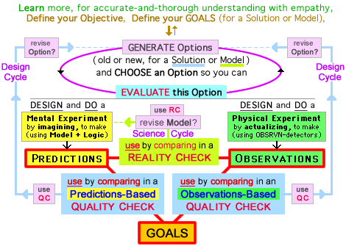

Slide 64
you compare Predictions with Observations, so you can
ask The Science Question: "am I surprised?"
because (oops) something is wrong with my THEORY (about how the world works) so revise Theory?
or my PREDICTIONS (my Process-of-Predicting),
the OBSERVATIONS (re: Process, Instruments,...), the EXPERIMENT (understanding of Situation? or ... ).

Slide 65
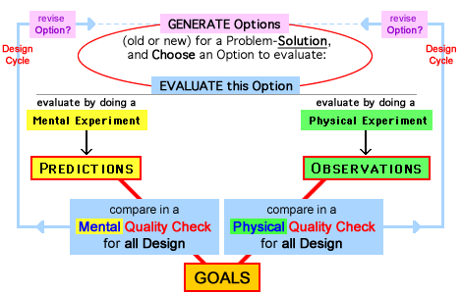

Slide 66
Quality Checks = asking The Design Question
How?
you compare GOALS with PREDICTIONS or OBSERVATIONS
so you can ask
THE Design Question (e.g. THE Engineering Question): "How close is the match?" when you compare what you will get what you want if This Option. in a Problem-Solution. ( Predicted Characteristics ) ( Desired Characteristics ) your Predictions versus your Goals

Slide 67
How do you define Quality ?
In a Quality Check, IF there is a close match of Predictions with Goals, This Option has high Quality, with Quality defined by your Goals, so This Option might be a good Solution.
But what can you do if there is not a close match?
You can ask "should I revise This Option?"

Slide 68
How do you define Quality ?
In a Quality Check, IF there is a close match of Predictions with Goals, This Option has high Quality, with Quality defined by your Goals, This Option might be a good Solution.
But what can you do if there is not a close match?
You can ask "should I revise This Option?"

Slide 69
IF there is not a close match between Predictions and Goals, ask "What are the mis-matches? what are the causes?" and "How can I revise This Option to get a closer match?"
a Cycle of Design can be first Generate and then Evaluate, and also first Evaluate and then Generate.

Slide 70
GUIDED GENERATION uses productive interactions between Critical Thinking and Creative Thinking so you are being productively Critical-and-Creative.
in a critical-and-creative process of Guided Generation your critical Evaluation of the Old Option stimulates and guides your creative Generation of a revised New Option.
stimulates – revising is motivated by "I want a better match." guides – revising is guided by "how can I get a better match?"

Slide 71
a Quality Check can use Predictions or Observations:
We've looked at a Predictions-Based Quality Check , and you also can do an Observations-Based Quality Check to ask THE Design Question by comparing what you did get what you want with This Option. in a Problem-Solution. ( Observed Characteristics ) ( Desired Characteristics ) your Observations versus your Goals
Predictions-Based Quality Check, compares Predictions vs Goals. Observations-Based Quality Check, compares Observations vs Goals.
{ note: both Q-Checks are done mentally, so we don't do a Physical Q-Check.}

Slide 72
a Quality Check can use Predictions or Observations:
We've looked at a Predictions-Based Quality Check , and you also can do an Observations-Based Quality Check to ask THE Design Question by comparing what you did get what you want with This Option. in a Problem-Solution. ( Observed Characteristics ) ( Desired Characteristics ) your Observations versus your Goals
Predictions-Based Quality Check compares Predictions with Goals. Observations-Based Quality Check compares Observations with Goals.
{ note: both Q-Checks are done mentally , so we don't do a Physical Q-Check.}

Slide 74
Action-Diagrams and Action-Decisions:
each Actions-Diagram shows multiple actions that occur at different times during a process of problem solving.
each describes the same Problem-Solving Process, but... with different choices (about the actions to include); each is useful for describing PS-Process in different ways, each is useful for education in different ways.
For every PS-Project the sequence of actions can be different, because making Action-Decisions about "what to do next" IS like a Hockey Player's flexible goal-directed improvising, IS NOT like a Figure Skater's rigid choreography.
useful analogies? Hockey Player (yes), but Figure Skater (no).

Slide 75
Other Model-inventors agree with me in thinking that we should avoid a "choreographed process" because this isn't the way people typically solve problems.
___________________________________________________________________________
But there are important differences between my Model and most other Models. Partly it's the length of the "sequences" used in my Model and their Model. My sequences are made from small elements, in a way that most Models don't use. This is described in depth HERE (and I recommend reading it) but I've constructed new analogies – described in the next two slides – that are useful when we're thinking about an essential difference between my Model and most other Models.

Slide 76
As explained in the previous slide, "my sequences are made from small elements" in a way that isn't used in other Models. Here are two useful analogies:
I use elements that are short-time actions; these typically are combined in sequences (that can be short or longer), sort of like ATOMS combining to form MOLECULES of different sizes. By contrast, the sequences in Other Models usually are much longer "phases," analogous to OBJECTS made of molecules.
But although I use short-term actions, they're composed of much shorter neurological actions that are analogous to sub-atomics like protons-neutrons-electrons, or quarks or strings.

Slide 77
Or... in addition to the "chemistry" analogy (in previous slide) with my ATOMS forming MOLECULES that in their phases form OBJECTS, we can think of my elements being like LEGO Blocks, and their phases are like LEGO Objects made from Blocks.

Slide 78
My Model and Other Models: Cooperation, not Competition
My Model with Other Models, not My Model versus Other Models.
We should develop instruction to creatively combine different Models-for-Process, so the combination is more effective than any single Model by itself.
STRUCTURES + STRATEGIES STRUCTURES (for Instruction) + STRATEGIES (for Thinking)

Slide 79
My Model and Other Models:
We should develop instruction that combines different Models-for-Process creatively, so the combination is more effective for teaching ideas-and-skills. We want the Models to interact in ways that are synergistically supportive, that make the combination of Models better than any Model by itself.
Structures and Strategies: Typically, a Model-for-Process is educationally useful by providing structures (for instruction) and strategies (for thinking). Each Model has structures & strategies, so each offers its own benefits for students. When we effectively combine the structures & strategies from two (or more) Models, we combine their benefits.

Slide 80
Using Model-Structures to provide Structure for Instruction: Jeremy Utley, Director of Executive Education for Stanford's d.school, explains how their model [the next slide shows its 5 Modes] provides "a shared language and a shared approach" that can be "a useful scaffold to structure an experience for the purpose of learning." When students work in groups and everyone is thinking about the first mode (Empathize) in d.school's model, this whole-classroom focus makes it easier for a teacher to share ideas and guide students so they can use-and-understand the tools in this mode, so they will learn how to empathize more effectively using d.school's mindset of Focusing on Human Values. After awhile all students move on to the next mode (Define), and so on, in their "experience for the purpose of learning." And a teacher will use "the phases" with flexibility when it's useful.

Slide 81
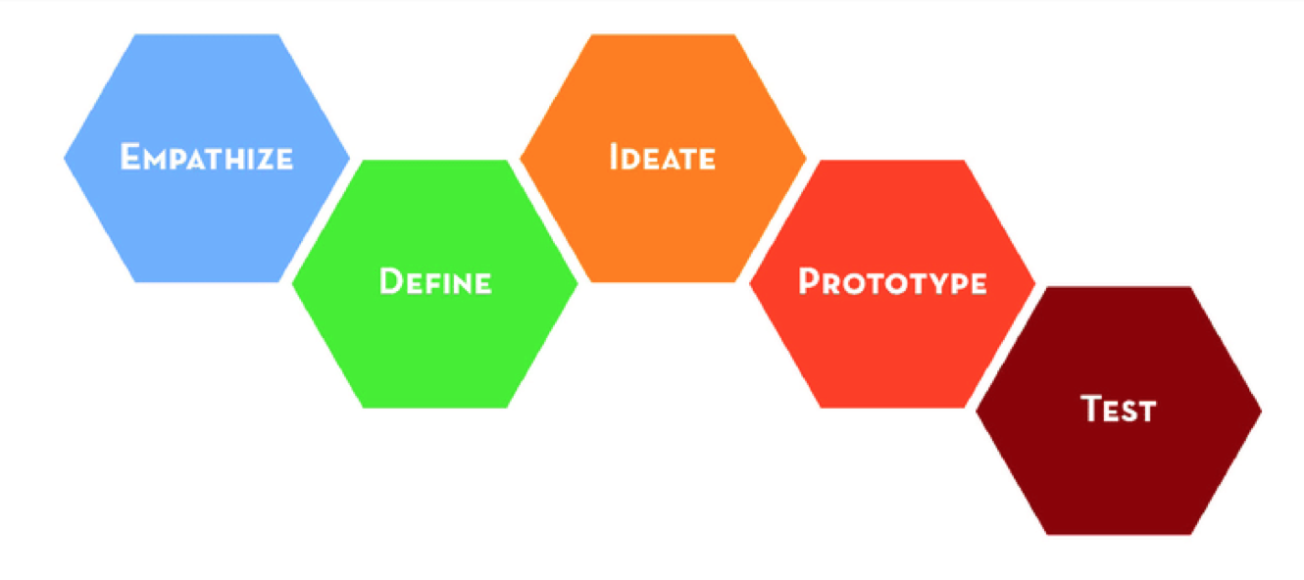
d.school (of Stanford) uses these five Modes (plus their Methods and Mindsets) to "structure an experience for the purpose of learning."

Slide 82
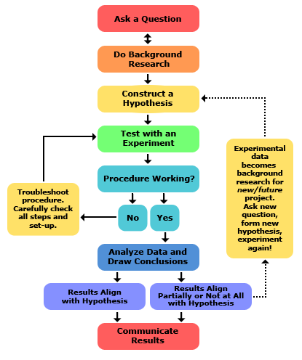
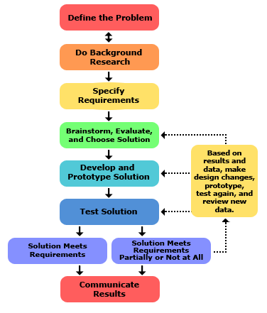
Science Buddies: Scientific Method Engineering Design Method

Slide 83
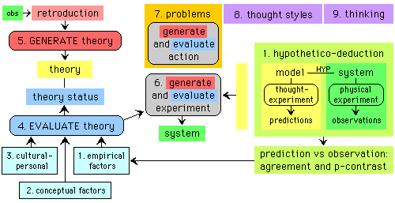
This a condensed mini-version of the model I developed for my PhD Dissertation. The next slide has the full-detail version of the diagram I made for Integrated Scientific Method that is described (briefly & deeply) in a collection of web-pages and word-documents.

Slide 84
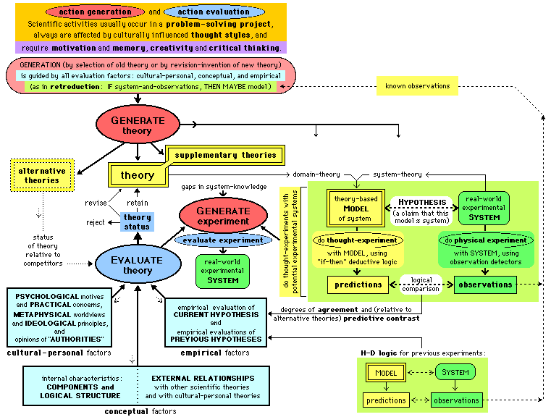

Slide 86
Maybe the next two slides were not necessary. I made them because I was embarrassed about having TMI-per-slide on many slides, so I wanted to minimize "the damage" if people were distracted by reading the TMI. And I wanted to apologize, saying "I knew better than to use PowerPoint in this way, but did it anyway."

Slide 87
a tip for multi-tasking: DON'T DO IT . ( i.e. don't TRY to do it – because we cannot do it ) ( "multi" really shifts back-and-forth, therefore lose a lot )
TIMINGS for Single-Tasking:
during the seminar, LISTEN.
after the seminar, READ, EducationForProblemSolving.net/eed/ or use LINKS in my bio: OSU-EED Seminar Page

Slide 88
Using PowerPoint Effectively: When I began developing this PowerPoint, one of my goals was to avoid TMI-per-Slide, but... I didn't achieve this goal, and many slides do have Too Much Information.
{ reasons to avoid TMI with Ppt – because humans cannot "multi"task – are explained in an excellent summary of research-about-Ppt. }
Therefore, because people are limited in how we multi-task (instead of "multi" we shift back-and-forth between different mental tasks, so it isn't really "multi") I urge you to focus on what I'm saying — without trying to get all information from a slide — so you can understand better with high-quality thinking in this one mode. Then if you want, later you can use this PowerPoint for a review of the many ideas.

Slide 89
This PowerPoint will end on the next slide, by describing Pros & Cons of providing Lots of Information, which is USEFUL in some ways, but NON-USEFUL in other ways.

Slide 90
TMI – Pros and Cons: My making-of-slides (with many having TMI) has its CONS because TMI can distract listeners during the seminar IF they try to multitask (poorly) by listening-AND-reading, and PROS because Too Much Information can be useful now, when you're reading this after the seminar, because This Information helps explain the ideas (filling the gaps now that were filled during the seminar with info I gave by talking.
But... if you want to deeply understand (and I hope you will), I recommend reading the Introductory Overview (including its Short Overview) in my edu-homepage, as explained near the beginning of this PowerPoint.

